Slide 2
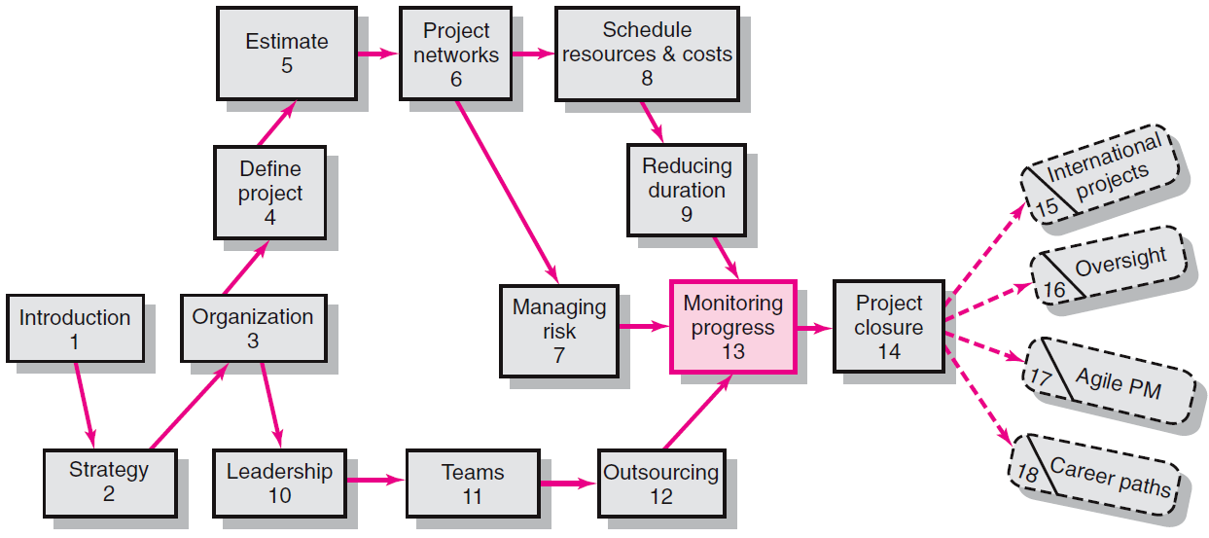
Where We Are Now
13–<number>

Slide 3
Structure of a Project Monitoring Information System
Creating a project monitoring system involves determining:
  What data to collect
  How, when, and who will collect the data
  How to analyze the data
  How to report current progress to management
13–<number>

Slide 4
Project Monitoring Information System
Information System Structure
  What data are collected?
    Current status of project (schedule and cost)
    Remaining cost to compete project
    Date that project will be complete
    Potential problems to be addressed now
    Out-of-control activities requiring intervention
    Cost and/or schedule overruns and the reasons for them
    Forecast of overruns at time of project completion
13–<number>

Slide 5
Project Monitoring System… (cont’d)
Information System Structure (cont’d)
  Collecting data and analysis
    Who will collect project data?
    How will data be collected?
    When will the data be collected?
    Who will compile and analyze the data?
  Reports and reporting
    Who will receive the reports?
    How will the reports be transmitted?
    When will the reports be distributed?
13–<number>

Slide 6
The Project Control Process
Control
  The process of comparing actual performance against plan to identify deviations, evaluate courses of action, and take appropriate corrective action.
Project Control Steps
  Setting a baseline plan.
  Measuring progress and performance.
  Comparing plan against actual.
  Taking action.
Tools
  Tracking and baseline Gantt charts
  Control charts
13–<number>

Slide 7
Developing an Integrated Cost/Schedule System
Define the work using a WBS.
  Scope
  Work packages
  Deliverables
  Organization units
  Resources
  Budgets
Develop work and
resource schedules.
  Schedule resources
  to activities
  Time-phase work packages into a network
Develop a time-phased budget using work packages included in an activity. Accumulate budgets (PV).
At the work package level, collect the actual costs for the work performed (AC). Multiply percent complete times original budget (EV).`
Compute the schedule variance (EV-PV) and the cost variance (EV-AC).
13–<number>

Slide 8
Development of Project Baselines
Purposes of a Baseline (PV)
  An anchor point for measuring performance
    A planned cost and expected schedule against
    which actual cost and schedule are measured.
    A basis for cash flows and awarding progress payments.
    A summation of time-phased budgets (cost accounts as summed work packages) along a project timeline.
What Costs Are Included in Baselines?
  Labor, equipment, materials, project direct overhead costs (DOC)
13–<number>

Slide 9

Development of Project Baselines (cont’d)
Rules for Placing Costs in Baselines
  Costs are placed exactly as they are expected to be “earned” in order to track them to their point of origin.
  Percent Complete Rule
    Costs are periodically assigned to a baseline as units of work are completed over the duration of a work package.
13–<number>

Slide 10
Methods of Variance Analysis
Comparing Earned Value
  With the expected schedule value.
  With the actual costs.
Assessing Status of a Project
  Required data elements
    Data Budgeted cost of the work scheduled (PV)
    Budgeted cost of the work completed (EV)
    Actual cost of the work completed (AC)
  Calculate schedule and cost variances
    A positive variance indicates a desirable condition,
    while a negative variance suggests problems or
    changes that have taken place.
13–<number>

Slide 11
Developing A Status Report:
A Hypothetical Example
Assumptions
  Each cost account has only one work package, and each cost account will be represented as an activity on the network.
  The project network early start times will serve as the basis for assigning the baseline values.
  From the moment work an activity begins, some actual costs will be incurred each period until the activity is completed.
13–<number>

Slide 12
Indexes to Monitor Progress
Performance Indexes
  Cost Performance Index (CPI)
    Measures the cost efficiency of work accomplished to date.
    CPI = EV/AC
  Scheduling Performance Index (SPI)
    Measures scheduling efficiency
    SPI = EV/PV
  Percent Complete Indexes
    Indicates how much of the work accomplished represents of the total budgeted (BAC) and actual (AC) dollars to date.
    PCIB = EV/BAC
    PCIC = AC/EAC
13–<number>

Slide 13
Additional Earned Value Rules
Rules applied to short-duration activities and/or small-cost activities
  0/100 percent rule
    Assumes 100 % of budget credit is earned at once and only when the work is completed.
  50/50 rule
    Allows for 50% of the value of the work package budget to be earned when it is started and 50% to be earned when the package is completed.
  Percent complete with weighted monitoring gates
    Uses subjective estimated percent complete in combination with hard, tangible monitoring points.
13–<number>

Slide 14
Forecasting Final Project Cost
Methods used to revise estimates of future project costs:
  EAC_{re}
    Allows experts in the field to change original baseline durations and costs because new information tells them
    the original estimates are not accurate.
  EAC_{f}
    Uses actual costs-to-date plus an efficiency index to project final costs in large projects where the original budget is unreliable.
13–<number>

Slide 15
Key Terms
Baseline budget
Control chart
Cost performance index (CPI)
Cost variance (CV)
Earned value (EV)
Estimated Cost at Completion—Forecasted (EAC_{f})
Estimated Cost at Completion—Revised Estimates (EAC_{re})
Percent complete index—budget costs (PCIB)
Percent complete index—actual costs (PCIC)
Schedule performance index (SPI)
Schedule variance (SV)
Scope creep
To complete performance index (TCPI)
Tracking Gantt chart
Variance at completion (VAC)
13–<number>

